Slide 1
Amazon Products
Vincent Nguyen
Data Integration Spring 2025

Slide 2
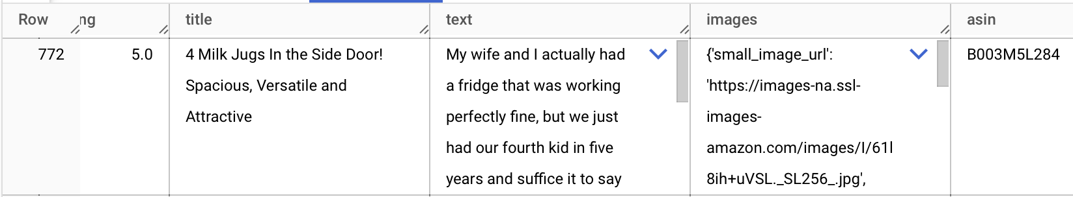
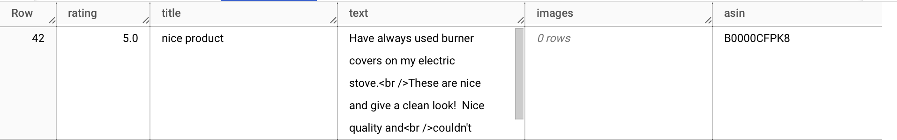
Theme
The goal of the project is to analyze the Amazon Products and Reviews Data to understand consumer behavior and sentiment in online shopping.

Slide 3
Data Sources
Product Reviews
Product MetaData
McAuley-Lab (UCSD) /Amazon-Reviews-2023
571.54M reviews
McAuley-Lab (UCSD) /Amazon-Reviews-2023
Richer Metadata
Prime User
Product Sales
Kaggle Dataset
Kaggle Dataset
Product MetaData 2
Categories
Julian McAuley, UCSD
143.7 million reviews spanning May 1996 - July 2014.
Google search

Slide 4
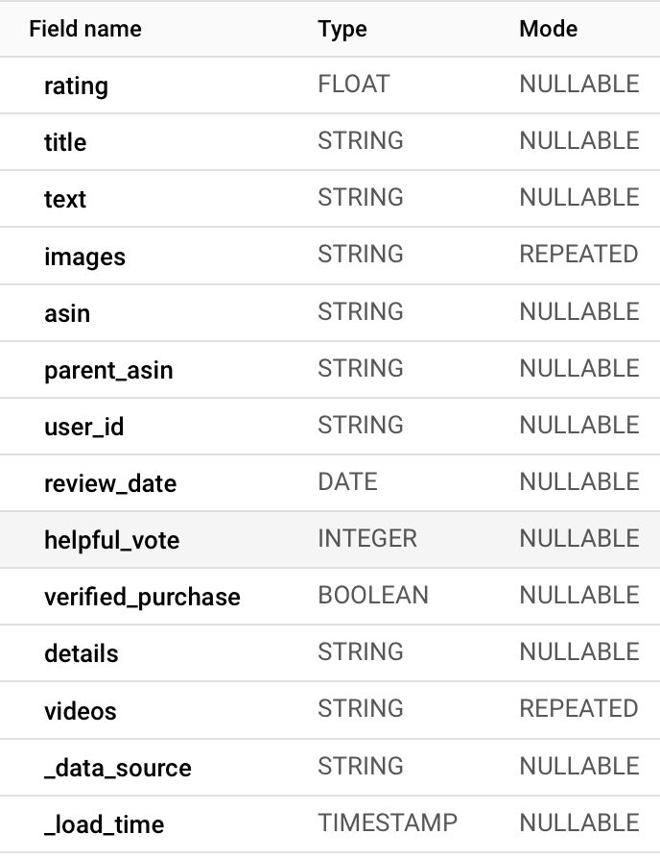
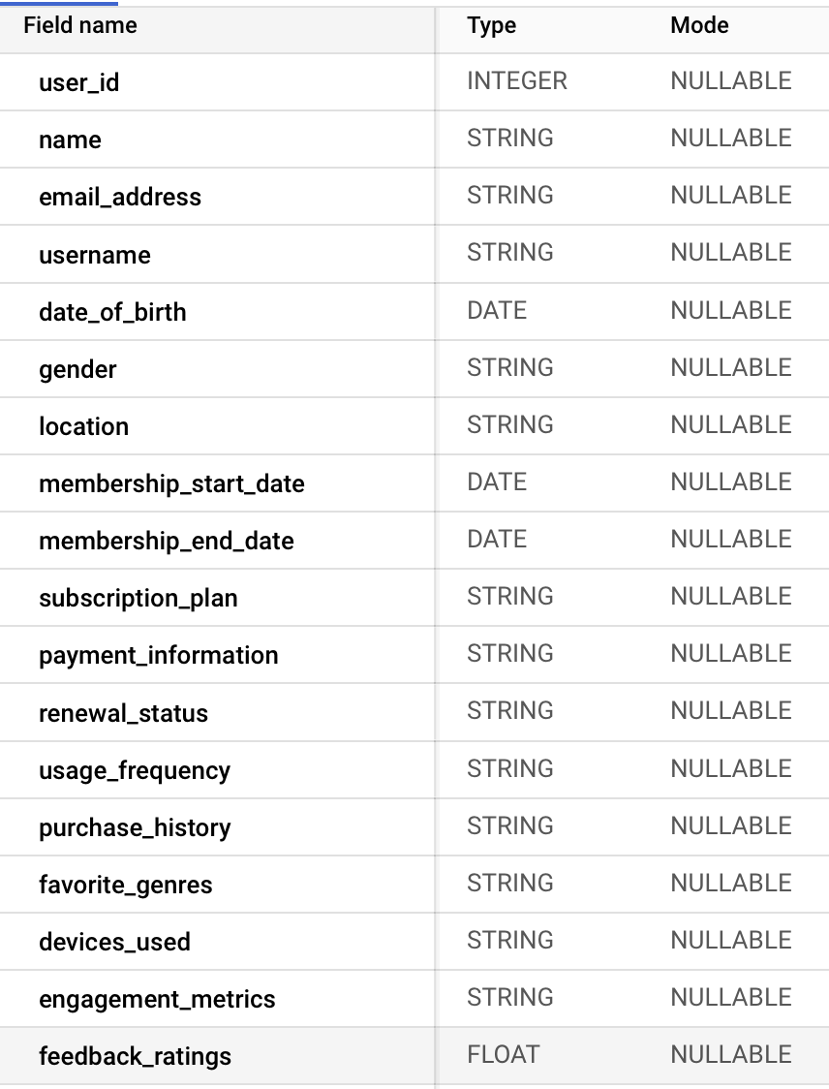
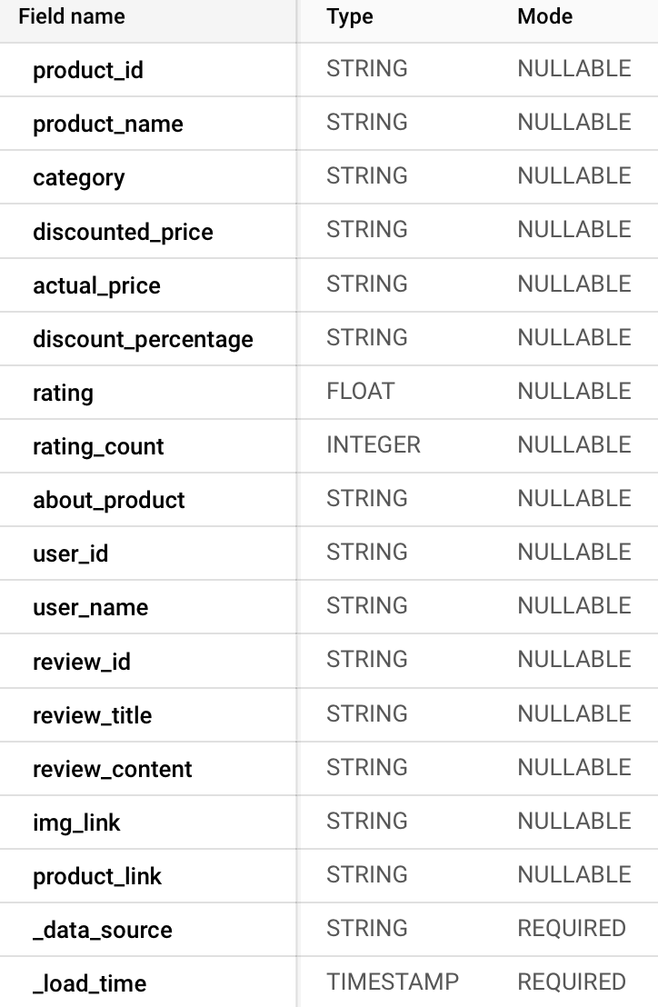
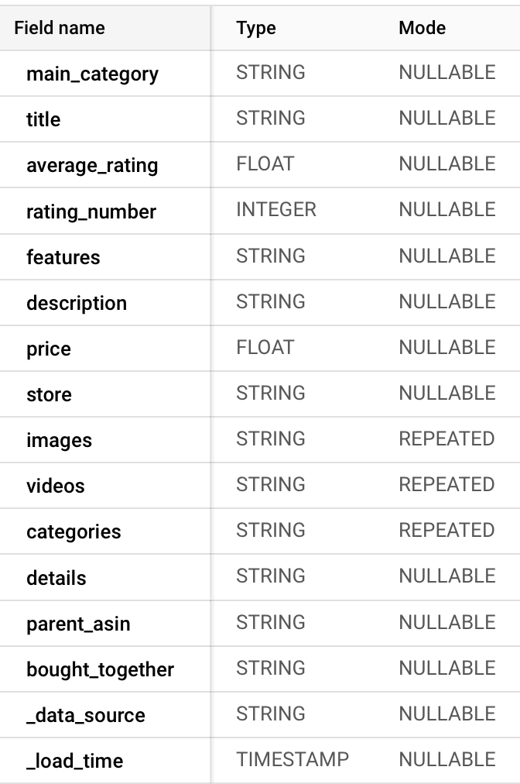
Data Sources
Product Reviews
User
Sales
Product Meta Data

Slide 5
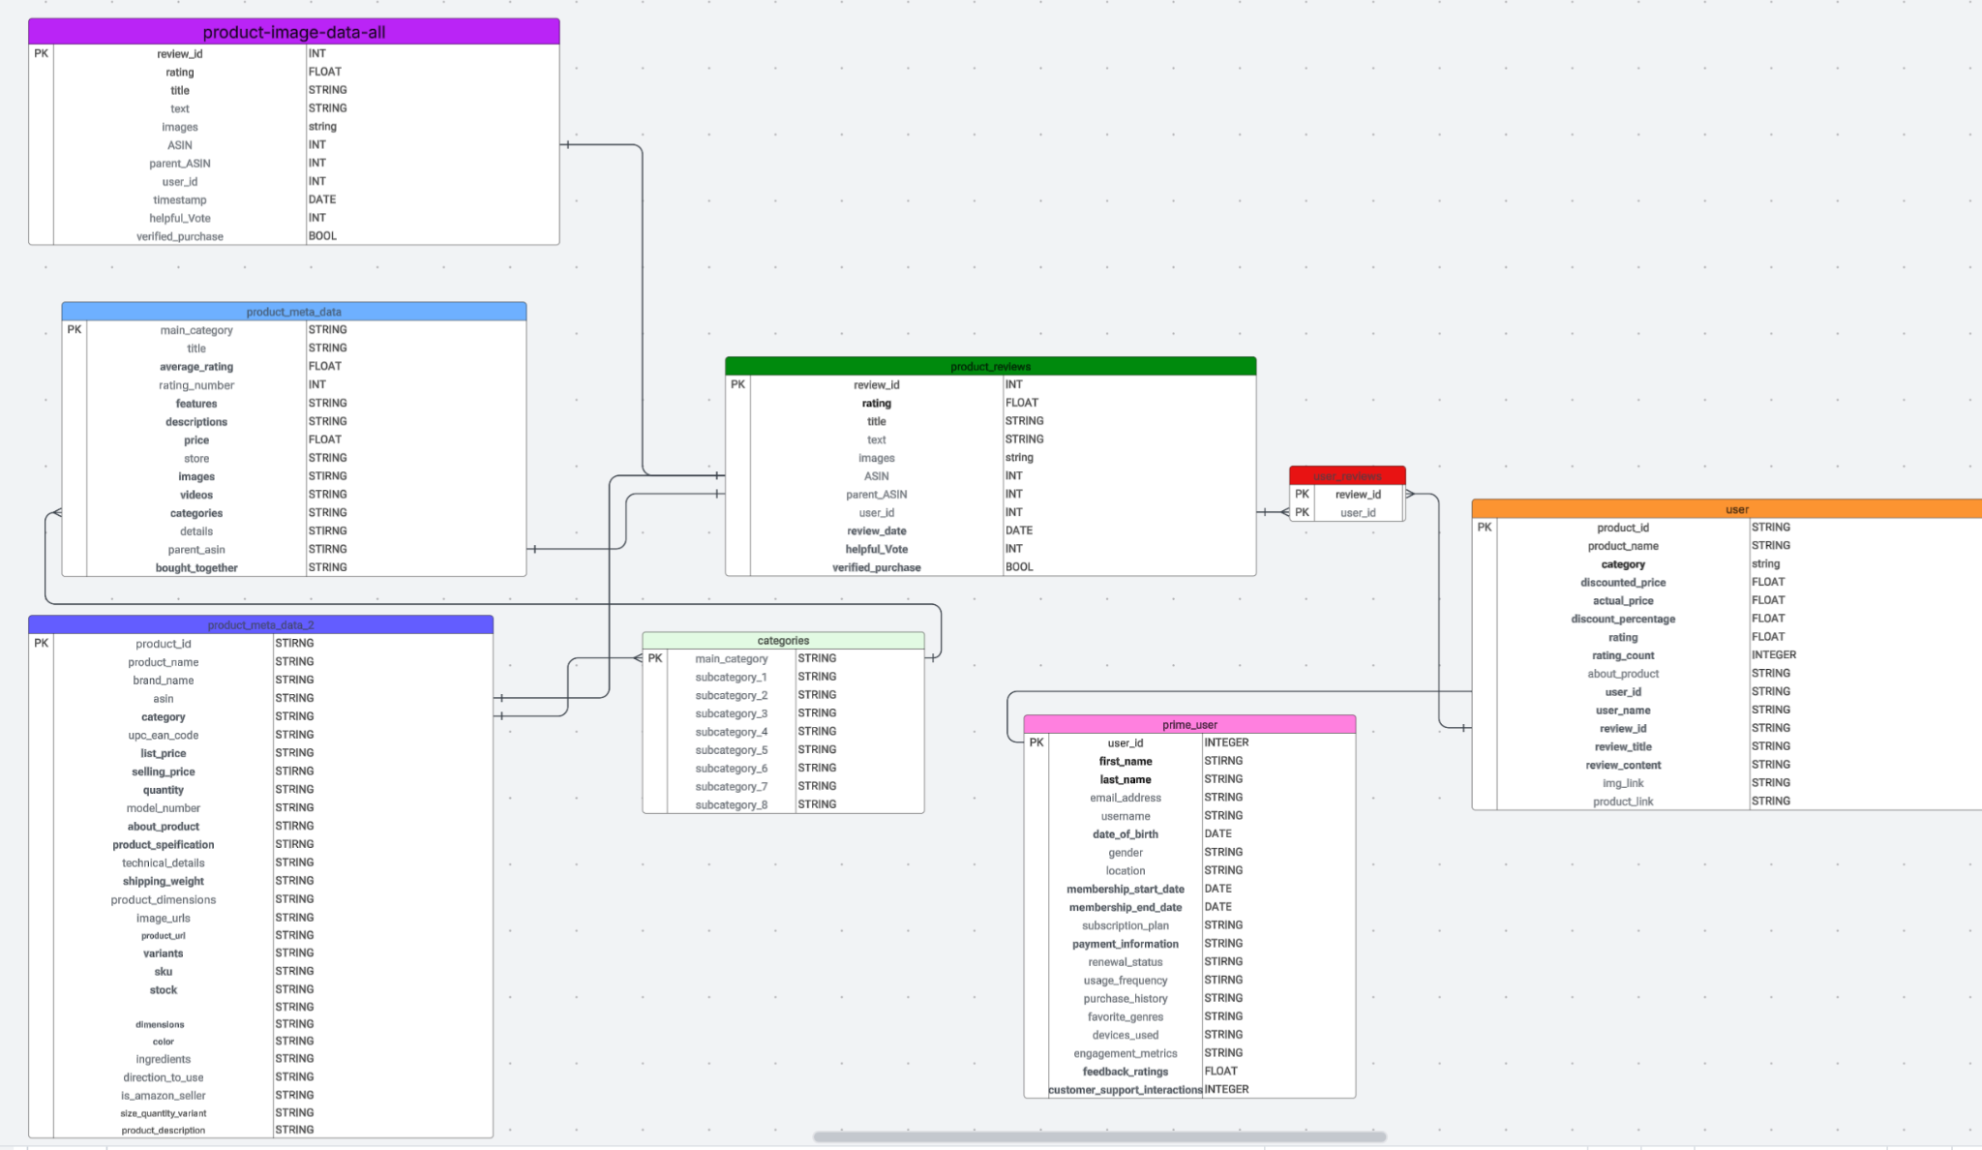
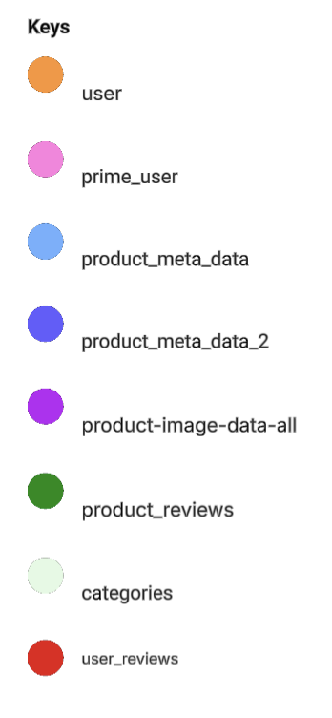
ERD Version 3
ERD

Slide 6
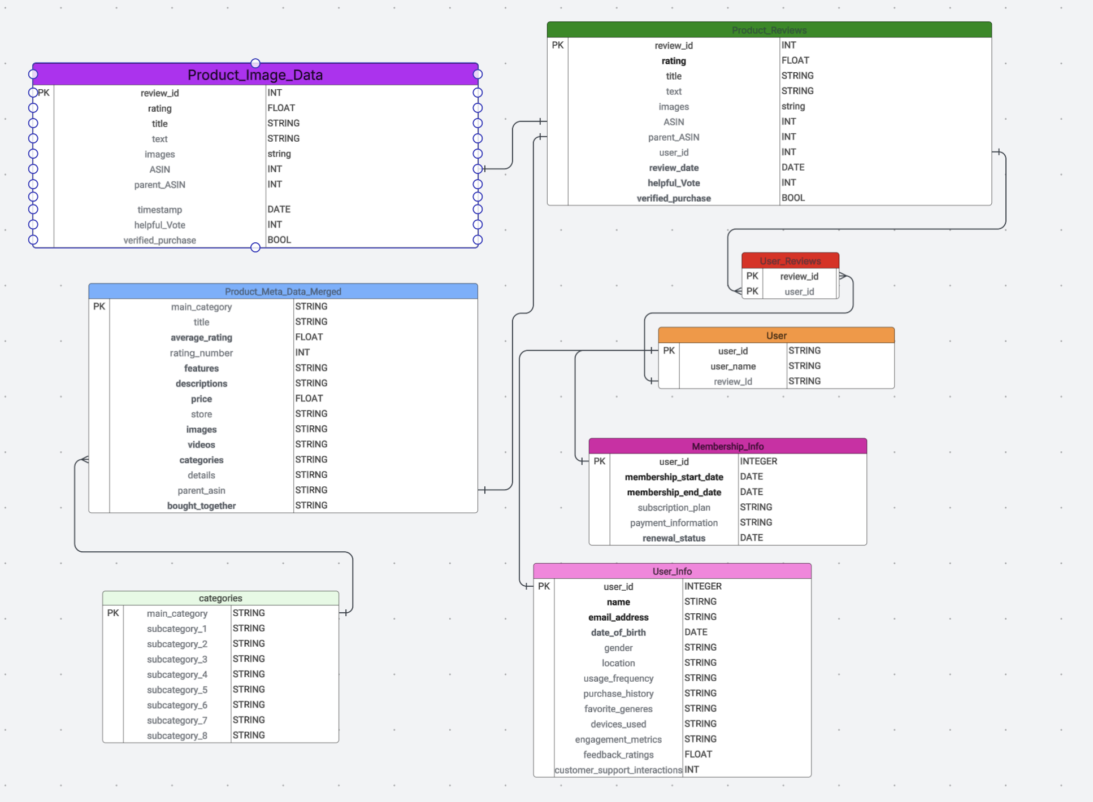
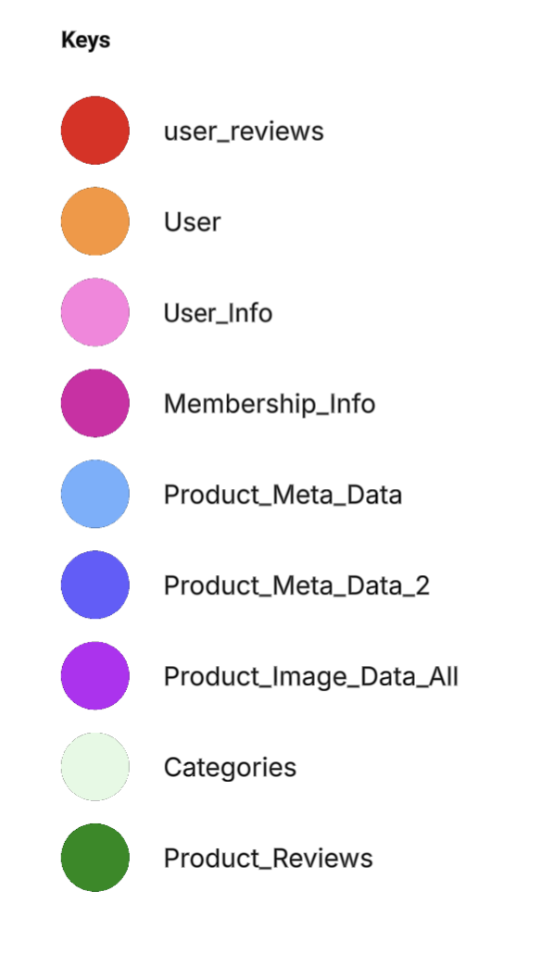
ERD Version 4
ERD

Slide 7
Embeddings
Embeddings: converting the review text into an embedding vector (text-embedding-005 model), creating a feature that allows our ML models to understand the content and nuances of the reviews. This embedding became a key input for predicting sentiment or helpfulness.
Bert Model: While embeddings capture meaning related to sentiment, we also wanted a direct classification of each review as POSITIVE or NEGATIVE along with a confidence score. This requires a model, a pre-trained sentiment analysis model (distilbert), specifically trained for sentiment analysis.

Slide 8
Goals
Hypothesis:
1) How do Prime memberships affect review sentiment?
2) How does User demographics affect review sentiment?
Use Case:
Stakeholder: Customer Retention Team
Why it matters: If Amazon can identify behavior or review patterns linked to longer memberships, it can better predict churn, tailor loyalty strategies, or offer targeted perks to high-retention users.

Slide 9
ML Models
Model 1 (rating vs membership_reg): It used rating as the target and included is_member as a feature, while crucially controlling for the review's content using embedding.
Model 2 (rating vs_age_reg) addressed one demographic aspect (age) by including user_age as a feature, controlling for embedding.
Model 3 (rating vs_member_userinfo_reg) tackled this more broadly by including various fields from User_Info like usage_frequency, engagement_metrics, feedback_ratings, devices_used, and customer_support_interactions. While not traditional demographics like location or income (which might not be available/used), these act as behavioral and profile characteristics.

Slide 10
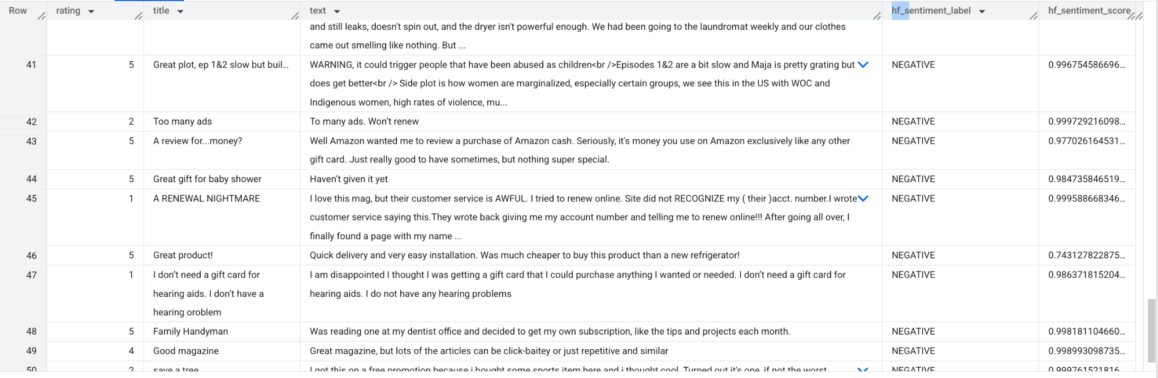
Roadblock

